Slide 1
Pixel Recurrent Neural Networks
011143085 (Md. Abid Hossain)
011161164 (Md. Rifat Alvi Habib)
011161163 (Suparna Shil)
011161123(Monowar Perves)
011161121(Md.Tanvir Islam)
011161040 (Sadia Islam)

Slide 2
Overview
Presented a deep neural network that sequentially predicts the pixels in an image along the two spatial dimensions.
The method described in the paper models the discrete probability of the raw pixel values and encodes the complete set of dependencies in the image.
Two types of LSTM layers are used which uses convolutions to compute at once the states along one of the spatial dimensions.
The models were tested on the CIFAR-10 dataset.

Slide 3
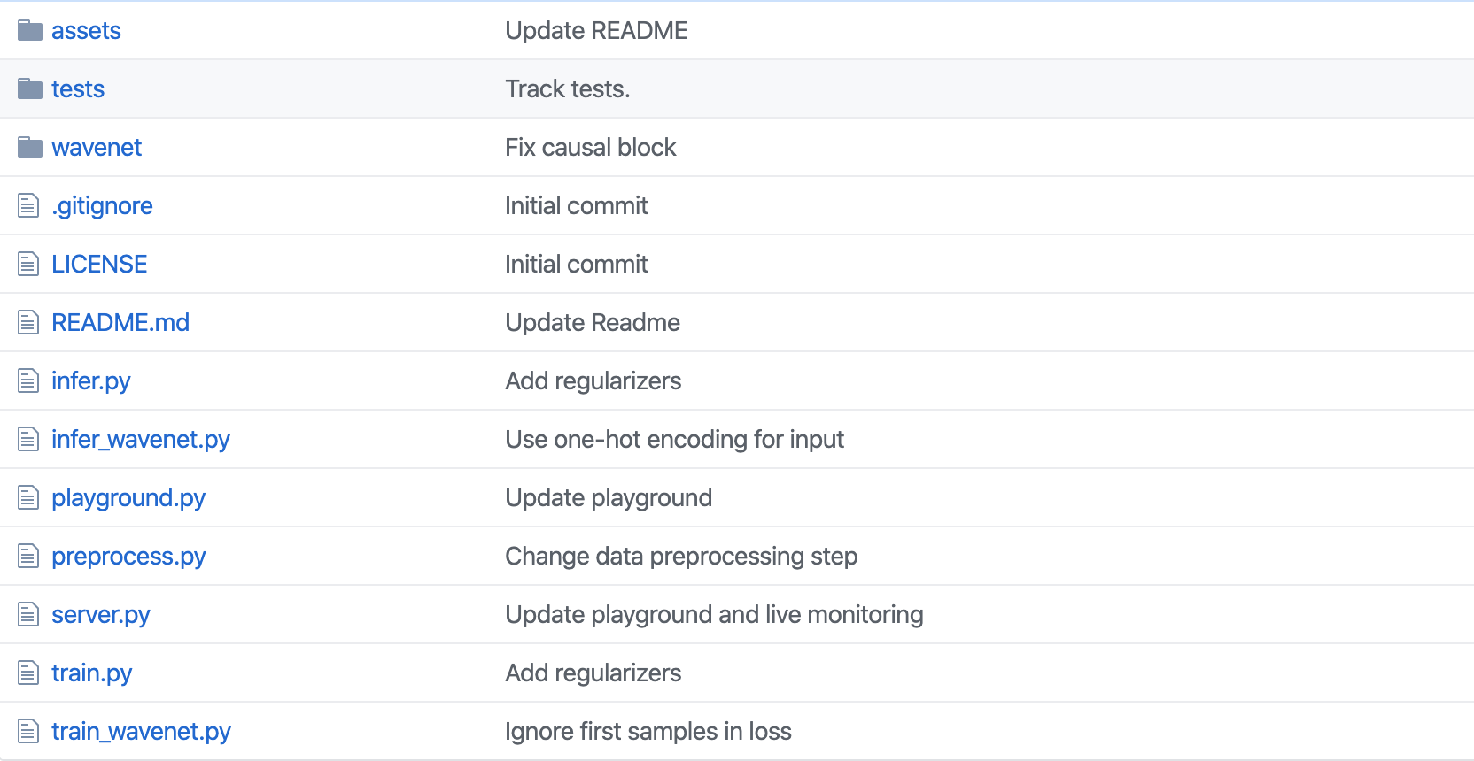
Github Code link
https://github.com/rampage644/wavenet

Slide 4
Github link
https://github.com/mdabhn/pixel-recurrent-neural-networks

